Slide 1
Individual homework
Propositional Logic
Filip-Daniel Crisan, group 912

Slide 2
Theoretical results
Theorem of deduction: if U1, U2, …, Un-1, Un |- V then U1, U2, …, Un-1 |- Un → V
The reverse of the theorem of deduction: if U1, U2, …, Un-1 |- Un → V then U1, U2, …, Un-1, Un |- V
We apply them n times

Slide 3



Slide 4


Slide 5



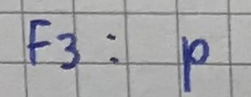


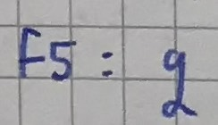

Slide 6



Slide 7


Slide 8
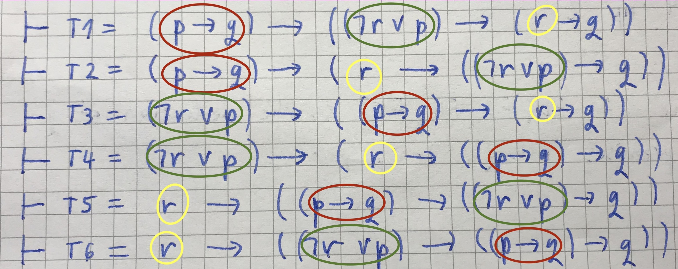

Slide 9
Thank you!

